Slide 1
TRAVEL THROUGH THE BIBLE

Slide 4
Where Did the Bible Come From?
LESSON 1

Slide 5
What a Book!
Bible comes from the Greek biblios, which means book
Scripture, which means writings
Contains the words that God spoke, so is also called God’s Word

Slide 7
What a Book!
Bible comes from the Greek biblios, which means book
Scripture, which means writings
Contains the words that God spoke, so is also called God’s Word

Slide 8
God's Words
2 Timothy 3:16–17
All Scripture is inspired, which means “God-breathed”
2 Peter 1:16–21
God inspired men through the Holy Spirit

Slide 9
Inspiration
God empowered men through the Holy Spirit to speak and write His truth

Slide 10
Inspiration

Slide 11
God Guided the Bible’s Human Authors
Several dozen people
Some unknown
Author of Job—around 1400 B.C.
Author of Hebrews—around A.D. 100

Slide 12
Read Exodus 34:27 and 1 Corinthians 2:10–13 to learn how God guided the human authors of the Bible.

Slide 13
One Story from God
Exodus 34:27
1 Corinthians 2:10–13

Slide 14
One Story from God
Exodus 34:27
God told Moses what to write
1 Corinthians 2:10–13
God’s Spirit taught people

Slide 15
God Communicated His Word to People
Two ways people communicate
Words
Actions

Slide 16
God Communicated His Word to People (cont.)
Two ways God communicated
God’s words are summarized in the Bible
God’s actions are summarized in Jesus Christ

Slide 17
Old Testament Divisions in English Bibles
Law
Beginning of time

Slide 18
Old Testament Divisions in English Bibles
Law
Beginning of time
Creation

Slide 19
Old Testament Divisions in English Bibles
Law
Beginning of time
Creation
Nation of Israel

Slide 20
Old Testament Divisions (cont.)
History
1,000 years of Israel’s history
Conquest of the Promised Land
Judges
Kingdoms
Prophets

Slide 21
Old Testament Divisions (cont.)
Poetry—Wisdom Literature
Poems

Slide 22
Old Testament Divisions (cont.)
Poetry—Wisdom Literature
Poems
Songs

Slide 23
Old Testament Divisions (cont.)
Poetry—Wisdom Literature
Poems
Songs
Proverbs, wise sayings

Slide 24
Old Testament Divisions (cont.)
Major Prophets—Isaiah to Daniel
Four prophets during time of Israel’s kings
Minor Prophets—Hosea to Malachi
Twelve prophets during time of Israel’s kings

Slide 25
Prophet?

Slide 26
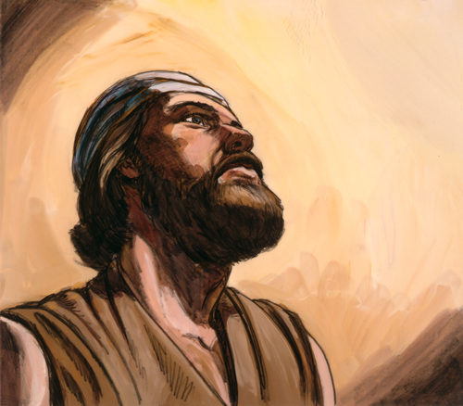
Prophet?
God’s spokesman; one who speaks to others for God

Slide 27
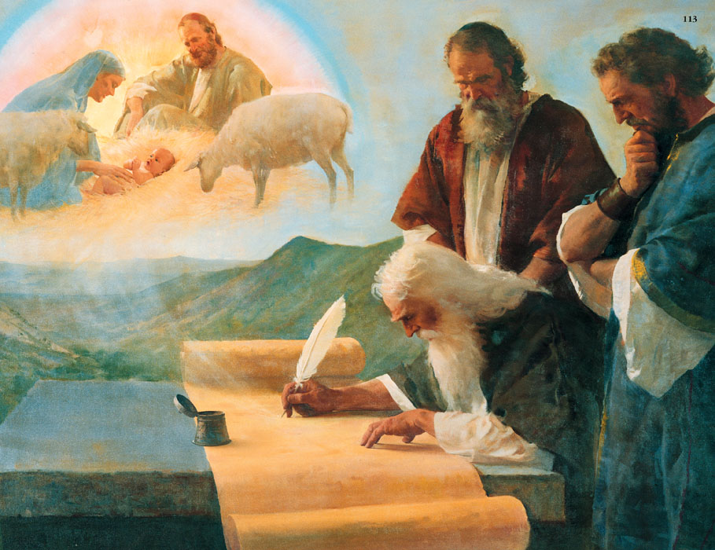
Prophecy
Words spoken by God through people; may include prediction of future events

Slide 28
Old Testament Books and Divisions

Slide 29
Law
Genesis
Exodus
Leviticus
Numbers
Deuteronomy

Slide 30
History
Joshua
Judges
Ruth
1 Samuel
2 Samuel
1 Kings
2 Kings
1 Chronicles
2 Chronicles
Ezra
Nehemiah
Esther

Slide 31
Poetry
Job
Psalms
Proverbs
Ecclesiastes
Song of Solomon

Slide 32
Major Prophets
Isaiah
Jeremiah
Lamentations
Ezekiel
Daniel

Slide 33
Minor Prophets
Hosea
Joel
Amos
Obadiah
Jonah
Micah

Slide 34
Minor Prophets (cont.)
Nahum
Habakkuk
Zephaniah
Haggai
Zechariah
Malachi

Slide 35
New Testament Divisions
Gospels
Jesus’ life death and resurrection

Slide 36
Gospel
Good news!

Slide 37
New Testament Divisions (cont.)
History—Acts
History of the early church
Paul’s Letters
Epistles from Paul to churches and friends

Slide 38
New Testament Divisions (cont.)
General Letters
Epistles from Peter and other church leaders
Prophecy—Revelation
Past, present, and future truth
Revelation of God

Slide 39
New Testament Books and Divisions

Slide 40
Gospels
Matthew
Mark
Luke
John

Slide 41
History
Acts

Slide 42
Paul’s Letters
1 Thessalonians
2 Thessalonians
1 Timothy
2 Timothy
Titus
Philemon
Romans
1 Corinthians
2 Corinthians
Galatians
Ephesians
Philippians
Colossians

Slide 43
General Letters
Hebrews
James
1 Peter
2 Peter
1 John
2 John
3 John
Jude

Slide 44
Prophecy
Revelation

Slide 45
Memory Verse/Homework
Genesis 1:27 (45 pts) - God created man in His own image, in the image of God He created him; male and female He created them.
Bible Divisions (25 pts) – OT:5, NT:5

